Slide 1
People Counter
Rahat Basher & Rayyan Hussain

Slide 2
What is a people counter?
Since the outbreak of Covid, governments have put restriction on the number of people in places so we have a come up with an App that counts the number of people present in a place to ensure rules are followed through Machine Learning algorithms and AI and to identify and inform authorities and managers about the population in a given area.

Slide 3
Why is AI a better solution?
In the long term, AI will be much more cost-effective due to it's requirement of only a camera and an algorithm running in the backend, that constantly learns from data it's provided with. The use of AI may also be more accurate than paying an employee to count, as large crowds may lead to human error in counting or may produce bias results if performed by someone working at the company.

Slide 4
How will it work?
The data is provided in a video format (mp4, avi) and has to show crowds moving from one end of an area to another. The camera must be placed at a birds eye view. It will make use of a compilation of videos of people from footage moving up and down to count how many people move in a downward direction and how many people move up, which will indicate the number of people entering and leaving, used in a calculation to produce an accurate population count of the area. The machine learning algorithm used is known as “CNN”.

Slide 5
Talking about the code

Slide 6
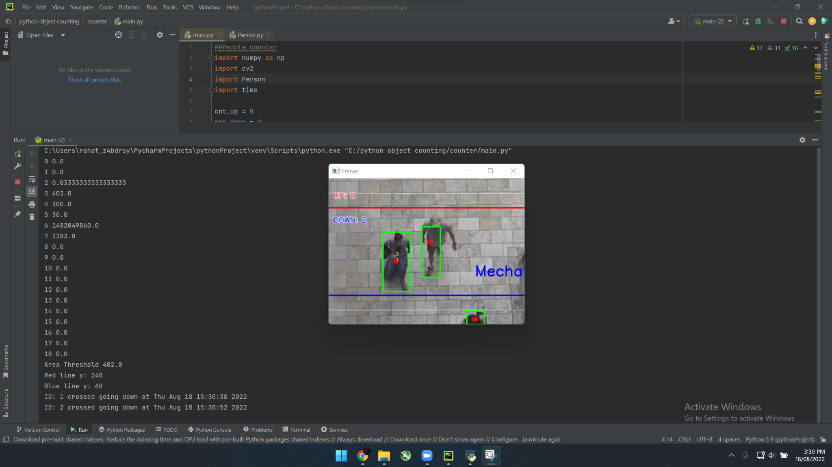
Example of code running

Slide 7
CNN algorithm
What is cnn?
A convolutional neural network (CNN) is a type of artificial neural network used in image recognition and processing that is specifically designed to process pixel data.
CNNs are powerful image processing, artificial intelligence (AI) that use deep learning to perform both generative and descriptive tasks, often using machine vison that includes image and video recognition, along with recommender systems and natural language processing (NLP).

Slide 8
Why is it better?
It’s more accurate than a person counting because there’s no chance of human error or biased results, and also ours can be used to view both people entering and leaving an area so it can calculate the population of the area.

Slide 9
Summary
Our project was creating a "People Counter" AI system to be used, now more than ever due to the pandemic, and throughout our development of the program we learnt about different methods of machine learning such as CNN (which was what we ended up incorporating). Our idea could be implemented world wide to reduce spread of disease, therefore highly profitable due to its demand from large companies and/or governments.

